Slide 1

Code Optimization
PRESENTED BY-
SANAKAR SHARMA (RA2011033010079) RISHU RAJ(RA2011033010082)

Slide 2
Optimization
In computing, optimization is the process of modifying a system to make some aspect of it work more efficiently or use fewer resources.
Ex: a computer program may be optimized so that it executes more rapidly or is capable of operating with less memory storage or other resources, or draw less power.
The system may be a single computer program, a collection of computers or even an entire network such as the internet.

Slide 3
Code Optimization
Optimization is a program transformation technique, which tries to improve the code that consume less resources (i.e. CPU, Memory) and deliver high speed.
In optimization, high-level general programming constructs are replaced by very efficient low-level programming codes.
Usually done at the end of the development stage since it reduces readability & adds code that is used to improve the performance.

Slide 4
Code Optimization
Optimized code’s features:-
Executes faster
Code size get reduced
Efficient memory usage
Yielding better performance
Reduces the time and space complexity

Slide 5
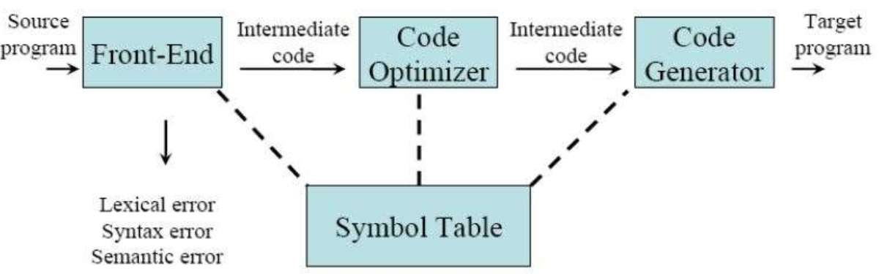
Code Optimization
Optimizations are classified into two categories:
Machine independent optimizations - improve target code without taking properties of target machine into consideration.
Machine dependent optimization - improve target code by checking properties of target machine.

Slide 6
Code Optimization
Criteria for Optimization:-
An optimization must preserve the meaning of a
program:
-Cannot change the output produced for any input.
-Can not introduce an error.
Optimization should, on average, speed up programs.
Optimization should itself be fast and should not delay the overall compiling process.

Slide 7
Code Optimization
Optimization can occur at several levels:
Design level:- At the highest level, the design may be optimized to make best use of the available resources.
– The implementation of this design will benefit from the use of suitable efficient algorithms and the implementation of these algorithms will benefit from writing good quality code.
Compile level:- Use of an optimizing compiler tends to ensure that the executable program is optimized at least as much as the compiler can predict

Slide 8
Code Optimization
Improvements can be made at various phases:-
Source Code: Algorithm's transformation can produce spectacular improvements
Intermediate Code: Compiler can improve loops,
procedure calls and address calculations.
-Typically only optimizing compilers include this phase
Target Code: Compilers can use registers efficiently

Slide 9
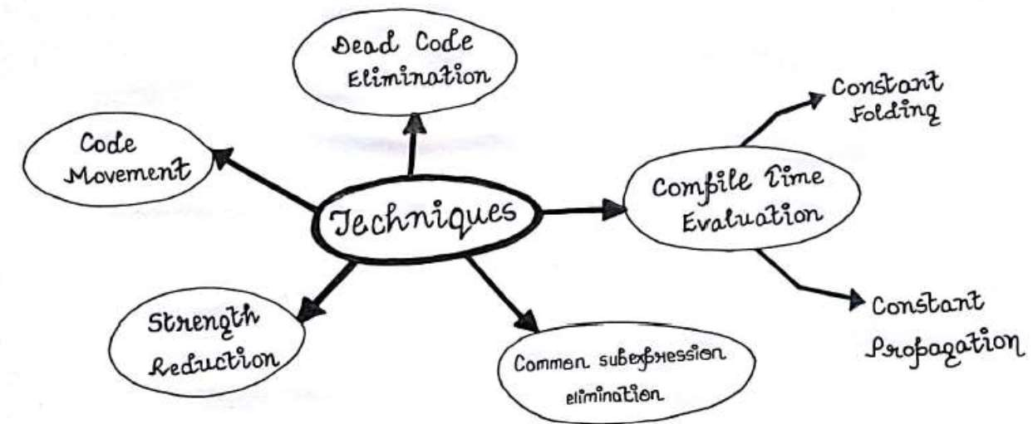
Code Optimization
Main techniques of Optimization:-

Slide 10
Code Optimization
There are primarily 3 types of optimizations:-
Local optimization - Apply to a basic block in isolation
Global optimization - Apply across basic blocks
Loop optimization – Apply on loops
Another significant optimization can be:-
peep-hole optimization - Apply across boundaries

Slide 11
Code Optimization
Optimization performed within a basic block.
This is simplest form of optimizations
No need to analyze the whole procedure body.
Just analyze the basic blocks of the procedure.
The local optimization techniques include:
Constant Folding
Constant Propagation
Algebraic Simplification
Operator Strength Reduction
Dead Code Elimination

Slide 12
Local Code Optimization
A) Constant folding-
As the name suggests, this technique involves folding the constants by evaluating the expressions that involves the operands having constant values at the compile time.
Ex: Circumference of circle = (22/7) x Diameter
Replace (22/7) with 3.14 during compile time and save the execution time.

Slide 13
Local Code Optimization
B) Constant Propagation-
In this technique, if some variable has been assigned some constant value, then it replaces that variable with its constant value in the further program wherever it has been used during compilation, provided that its value does not get alter in between.
Ex: pi = 3.14, radius = 10
Area of circle = pi x radius x radius
Substitutes constants value during compile time and saves the execution time.

Slide 14

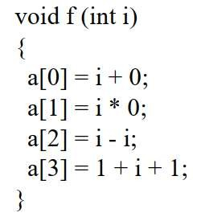
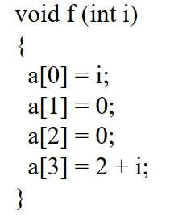
Local Code Optimization
C) Algebraic Simplification-
Use algebraic properties to simplify expressions
Some expressions can be simplified by replacing them with an equivalent expression that is more efficient.
Ex:

Slide 15
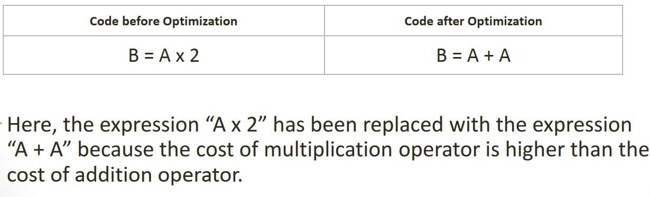
Code Optimization
D) Strength Reduction-
As the name suggests, this technique involves reducing the strength of the expressions by replacing the expensive and costly operators with the simple and cheaper ones

Slide 16
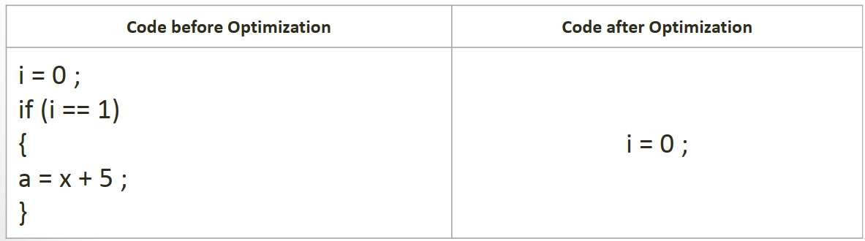
Code Optimization
E) Dead code elimination-
Those code are eliminated which either never executes or are not reachable or even if they get execute, their output is never utilized.

Slide 17
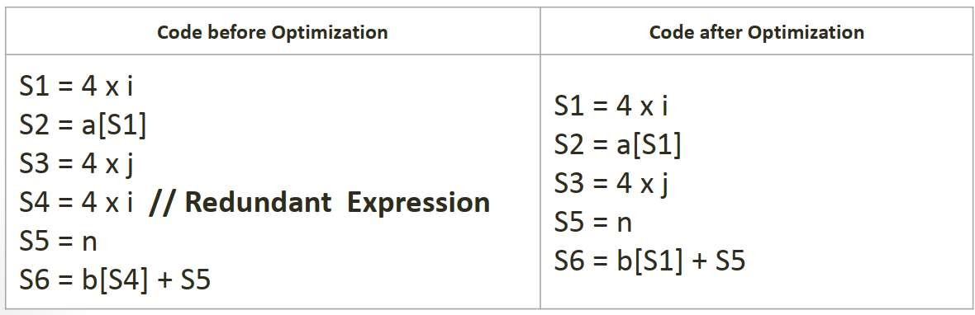
Code Optimization
F) Common sub-expressions elimination:
Eliminates the redundant expressions and avoids their computation again and again.

Slide 18
Global Code Optimization
Optimization across basic blocks within a procedure /function
Could be restricted to a smaller scope, Example: a loop
Data-flow analysis is done to perform optimization across basic blocks
Each basic block is a node in the flow graph of the program.
These optimizations can be extended to an entire control - flow graph
Most of compiler implement global optimizations with well founded theory and practical gains

Slide 19
Peephole Optimization
Optimization technique that operates on the one or few instructions at a time.
Performs machine dependent improvements
Peeps into a single or sequence of two to three instructions (peephole) and replaces it by most efficient alternative (shorter or faster) instructions.
Peephole is a small moving window on the target systems

Slide 20
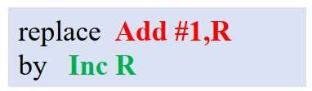
Peephole Optimization
Characteristics of peep-hole optimizations:-
Redundant-instruction (loads and stores)elimination
Flow-of-control optimizations - - Elimination of multiple jumps (i.e. goto statements)
Elimination of unreachable code
Algebraic simplifications
Reducing operator strength
Use of machine idioms

Slide 21
Loop Optimization
Loop optimization plays an important role in improving the performance of the source code by reducing overheads associated with executing loops.
Loop Optimization can be done by removing:
Loop invariant
Induction variables

Slide 22
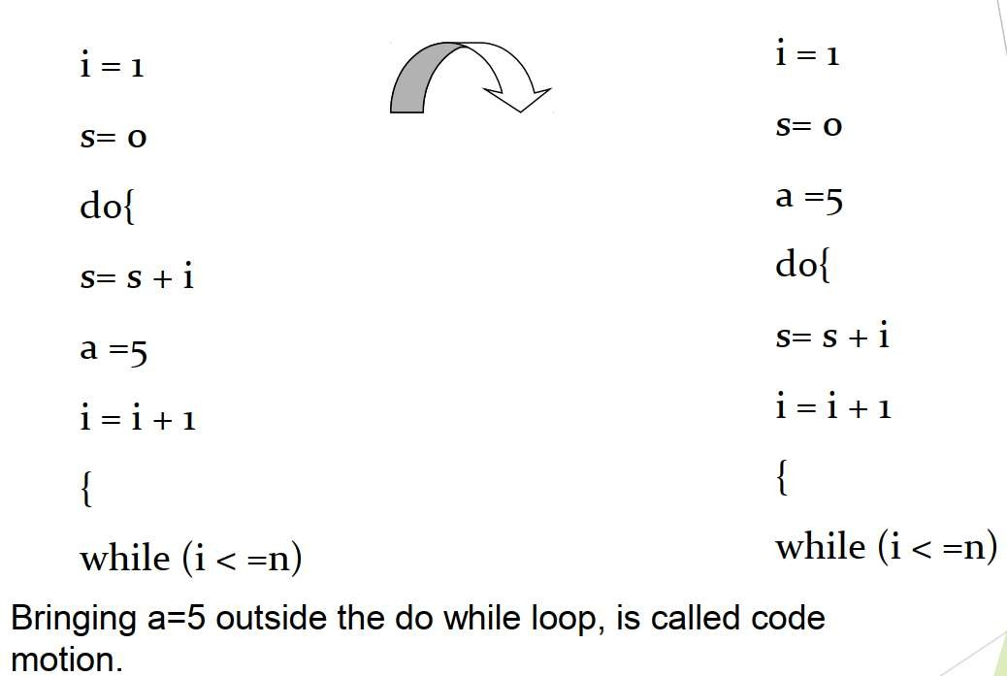
Loop Optimization
Removal of Loop Invariant data:-

Slide 23
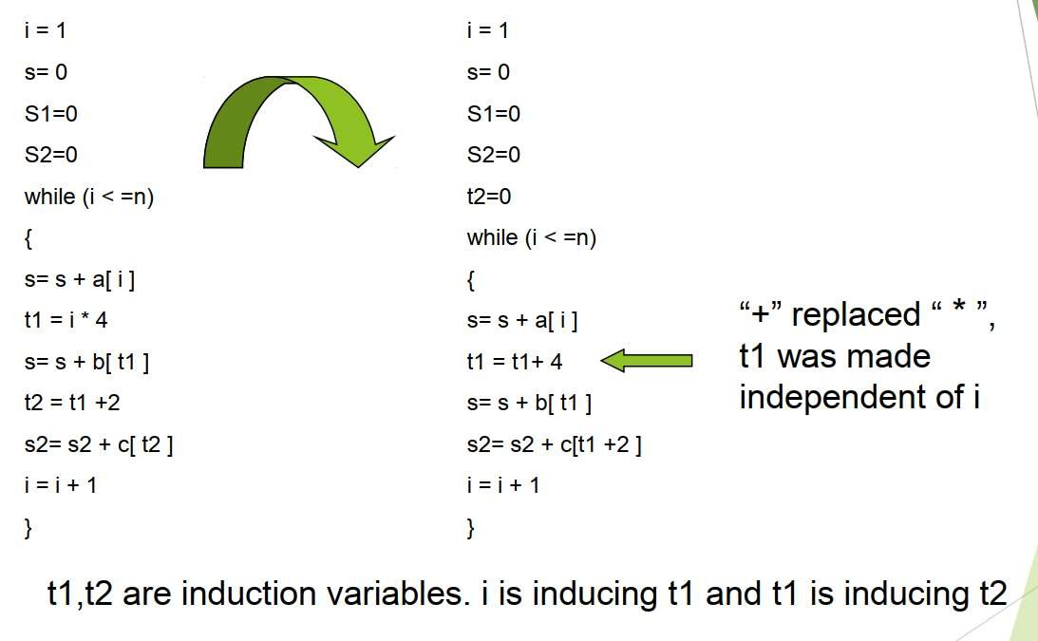
Loop Optimization
Induction variables:-

Slide 24
THANK YOU !!!

